Slide 1


CAPSTONE PROJECT
Netflix movies and TV show Clustering

Slide 2

TEAMMATES
TEAM MEMBERS:
1. PRATIK GHODKE
2. MADHURI BONELA
This Photo by Unknown Author is licensed under CC BY-NC

Slide 3

Netflix movies and TV shows Clustering

Slide 4
Netflix is world's largest online entertainment platform with many entertertainment shows in it that are streaming across the world wide.
it was founded on august 29 ,1997 in los gatos ,california by Mark and Reed .
Netflix had approximately 223 million paid subscribers worldwide as of the third quarter of 2022 and still its count is increasing to 2.5 million susubscribersfor the next quarter .
Netflix is available in more than 190 countries with more than 100 million hours of tv shows and movies per day.
Netflix has many series ,documentaries ,dramatic comedy shows and many feature films online entertaining every age group people around the world .
In this project i was curious to separate the shows according tomost liked shows by people according to their age and what type of content is liked mostly by particular age group people and visualizations of those with the help of clustering we have sorted thisto analyze and visualized and separated every group people .

Slide 5
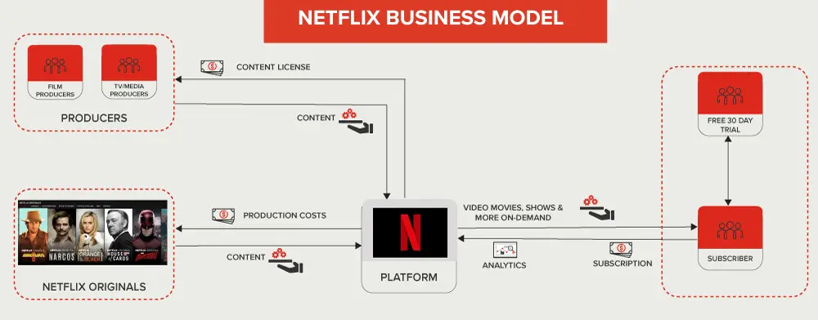

Slide 6
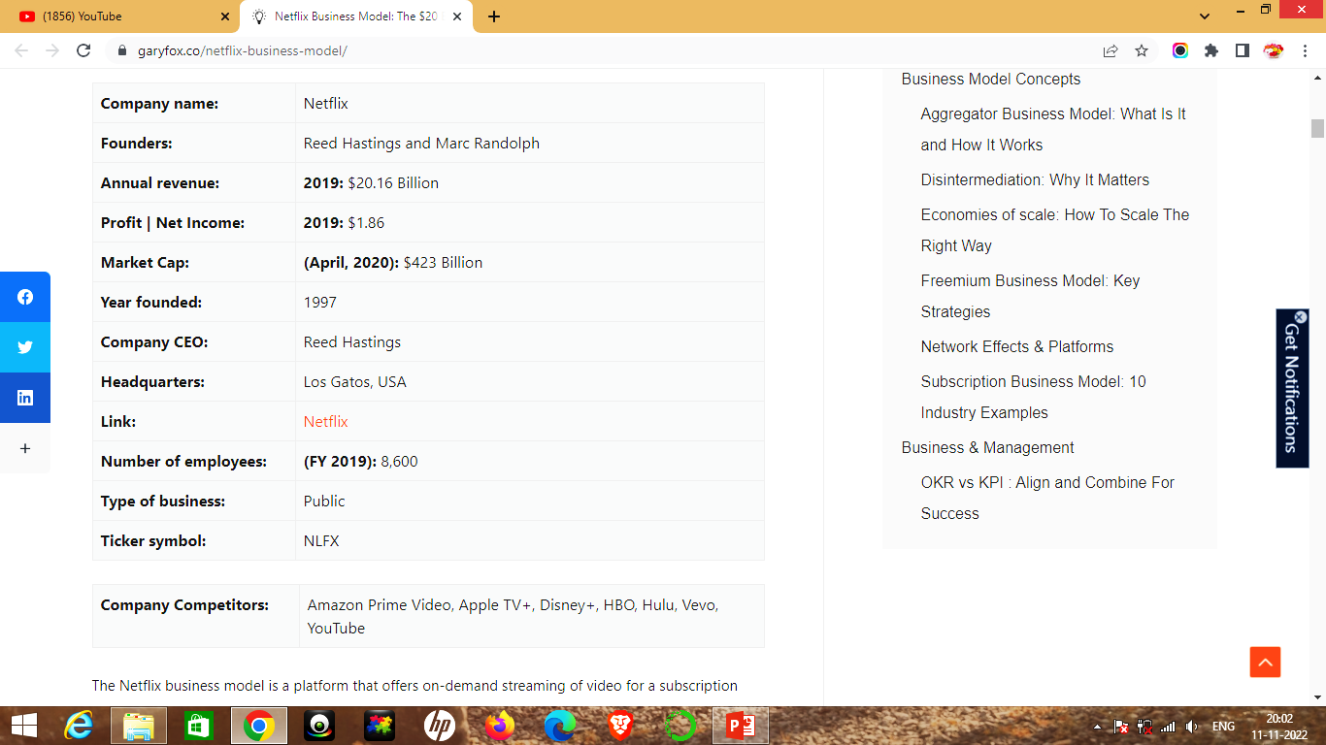

Slide 7
PROBLEM STATEMENT
1.Exploratory Data Analysis
2.Understanding what type of content is available in different countries
3.Is Netflix has increasingly focusing on Tv rather than movies in recent years
4.Clustering similar content by matching text -based features

Slide 8

1.Exploratory Data Analysis

Slide 9
Attribute Information
show_id : Unique ID for every Movie / Tv Show
type : Identifier - A Movie or TV Show
title : Title of the Movie / Tv Show
director : Director of the Movie
cast : Actors involved in the movie / show
country : Country where the movie / show was produced
date_added : Date it was added on Netflix
release_year : Actual Releaseyear of the movie / show
rating : TV Rating of the movie / show
duration : Total Duration - in minutes or number of seasons
listed_in : Genere
description: The Summary description

Slide 10
Percentage of Null values
The null values in director is of about 30.68%.
The null valuesin cast is of about 9.22%.
The null values in country is about 6.51%.
The null values in date_added is about 0.13%.
The null values in rating is about 0.09%.
The null values are dropped for the columns of
date_added and rating .

Slide 11
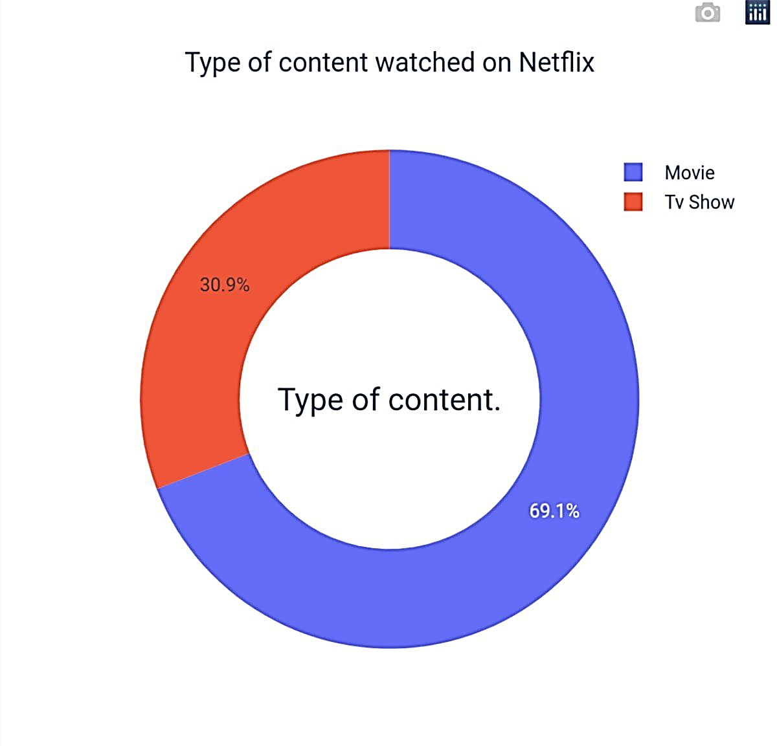
1.Type of content watched on Netflix
Movie show watched on Netflix is about 69.1% .
Tv show watched on Netflix is about
30.9%.
The maximum area part is constituted of blue part with highest number of movie show at Netflix .

Slide 12
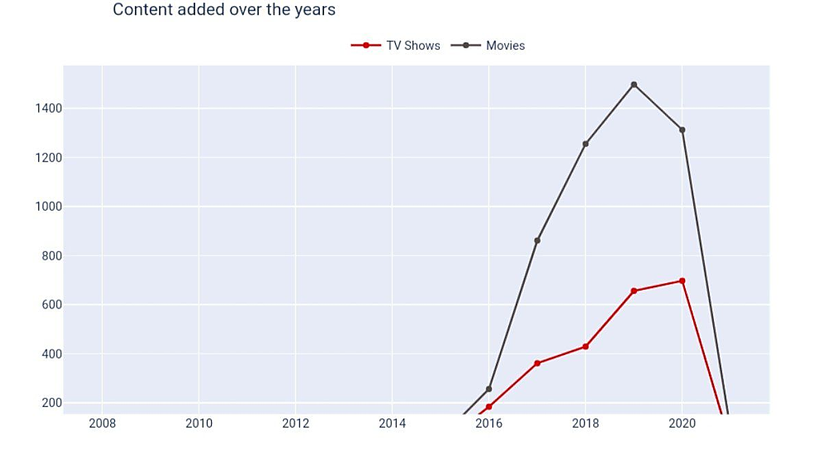
2.Content added over years
Red graph indicates Tv shows
Black graph indicates Movies
The more number of movies were added then of Tv shows from 2016 to 2020 .
Growth in the number of movies on Netflix is much higher than tv shows

Slide 13
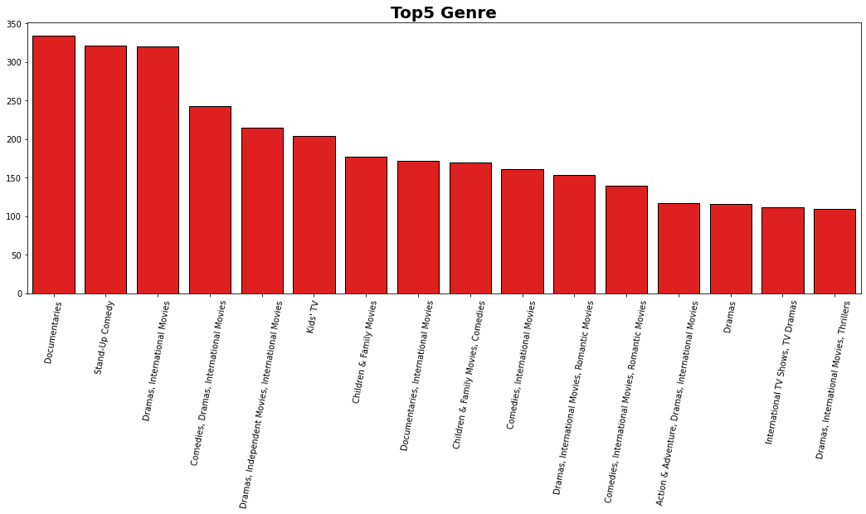
3.Top 5 Genres for Movies/Shows on Netflix
Documentaries and standup comedy ,Dramas are the most watched Genres.

Slide 14
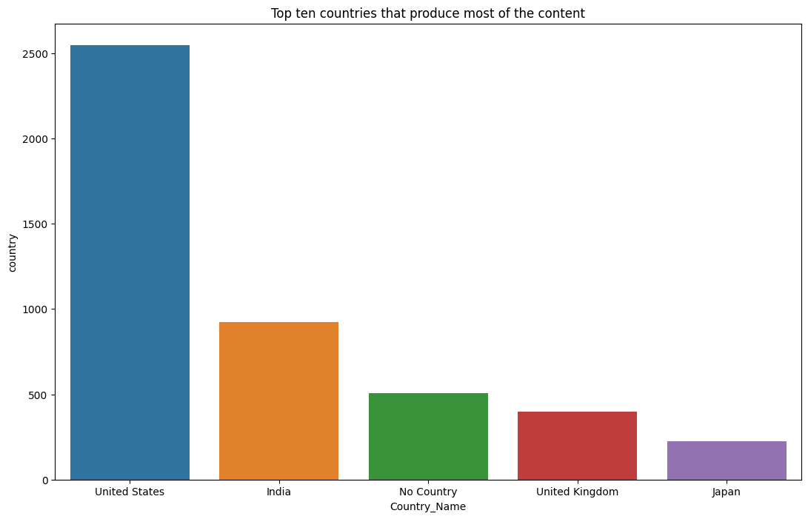
4.Top 5 countries that produce most of the content
United states is highest in terms of produce of most of the content .
Second is INDIA that produce most of the content .
After countries like united kingdom and japan produce most of the content .

Slide 15
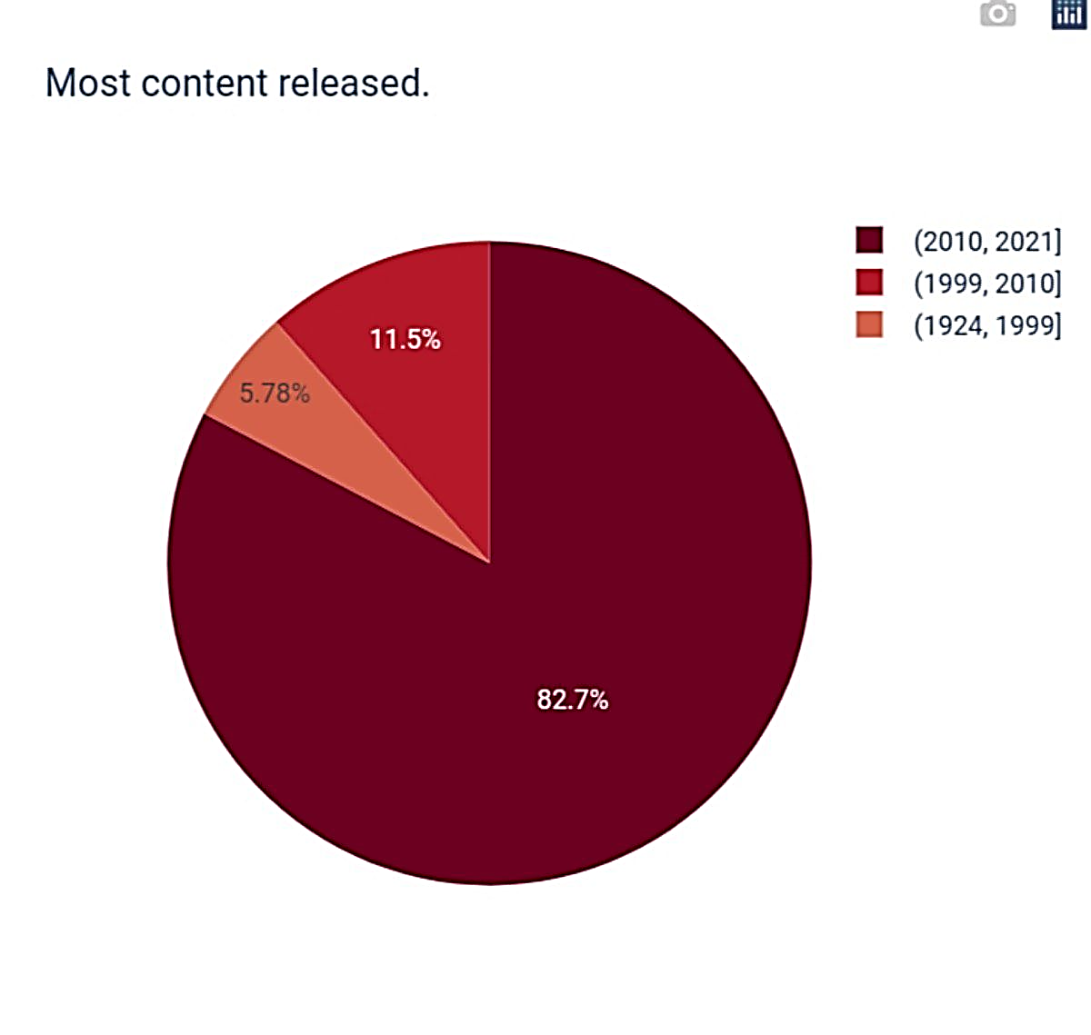
5.Most content released
The most of the content released about maximum area part of nearly 82.7%
area from(2010,2021)
The next most of the contents of about 11.5% area from (1999,2010)
The next most of the content is of about 5.78% from (1924 ,1999)

Slide 16
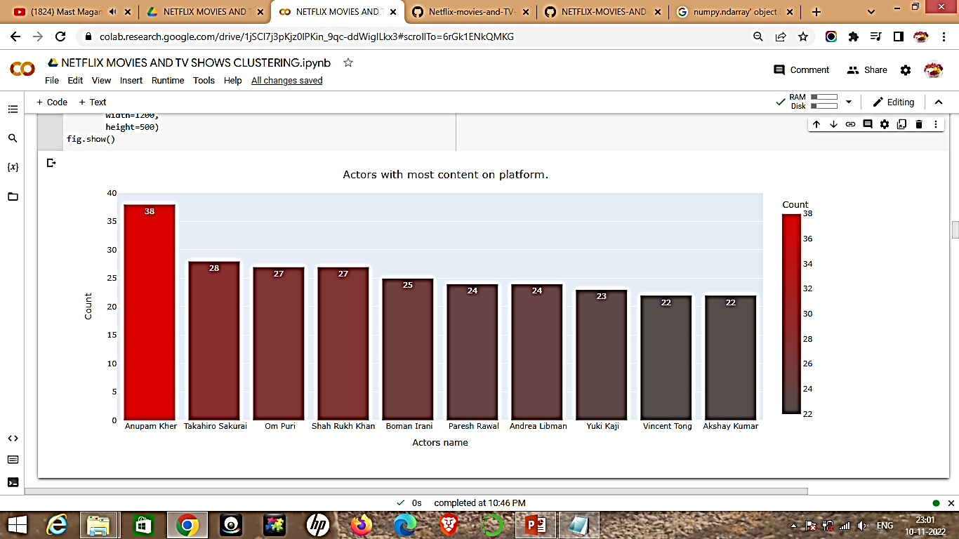
6.Actors with most content on platform
The actor with most highest content on platform is Anupam kher .
The second highest actor with most content on platform is Takahiro Sakurai .
The third highest actor with most content is Om puri .
Therefore the actors with most highest content is visualized in descending order .

Slide 17
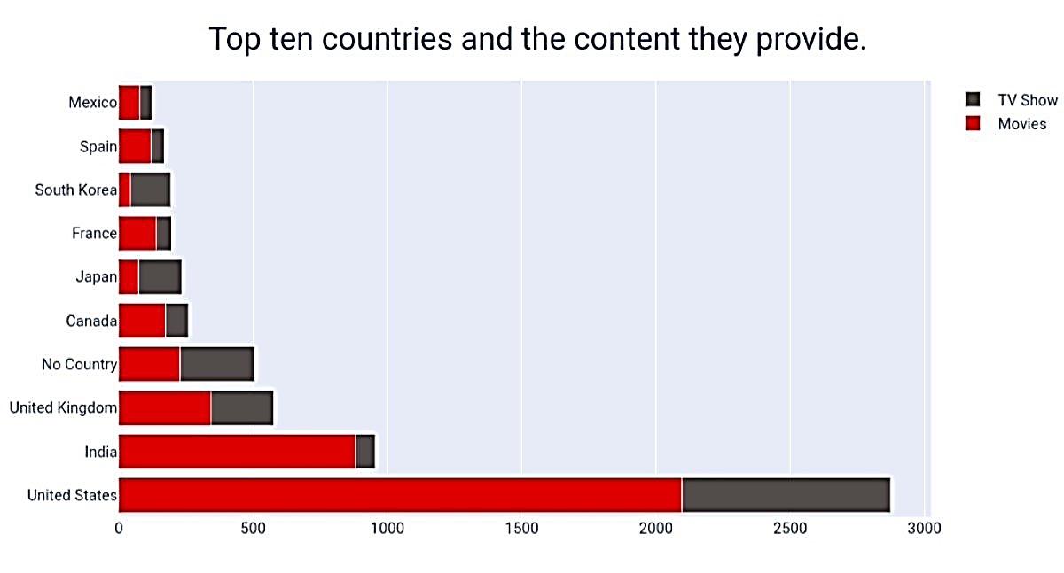
7.Top 10 countries and the content they provide
Every country provides both the Tv shows and movies.
The country with highest content of Tv shows and movies is united states .
From descending order the top 10 countries are visualized.

Slide 18
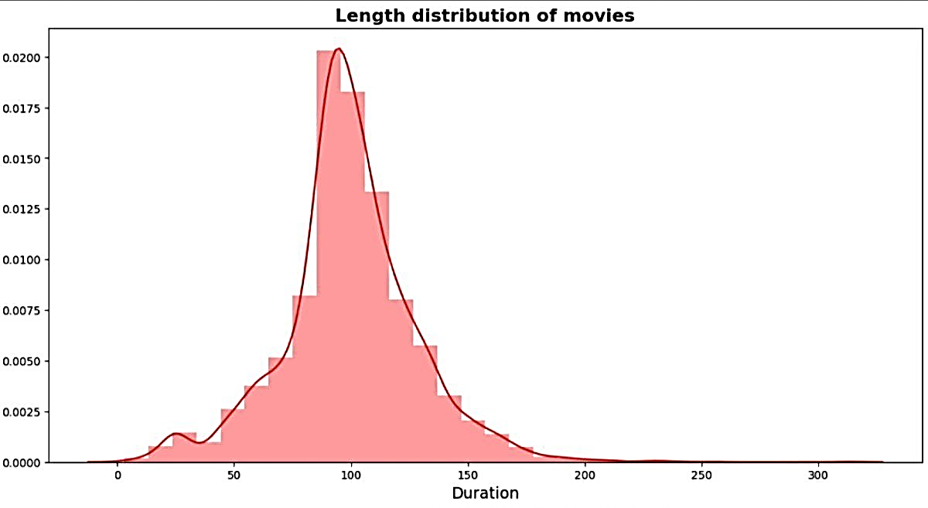
8.Length distribution of movies
The length of distribution of movies is expanding in visual distribution.
The visual distribution is normal distribution.
Most of the movies last for 90 to 120 minutes

Slide 19
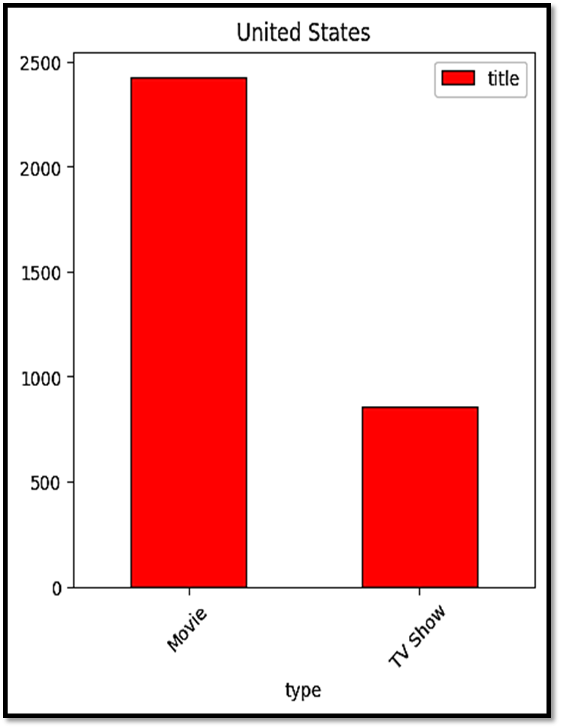
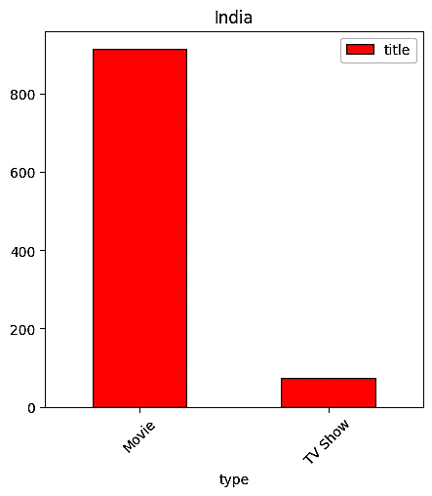
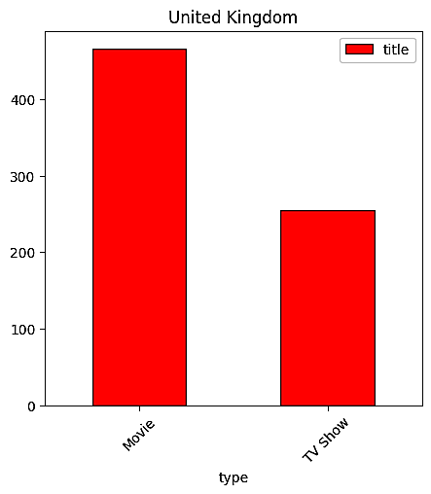
9.Country vs type

Slide 20
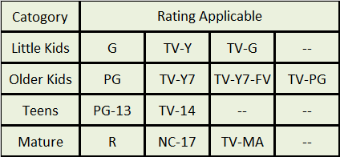
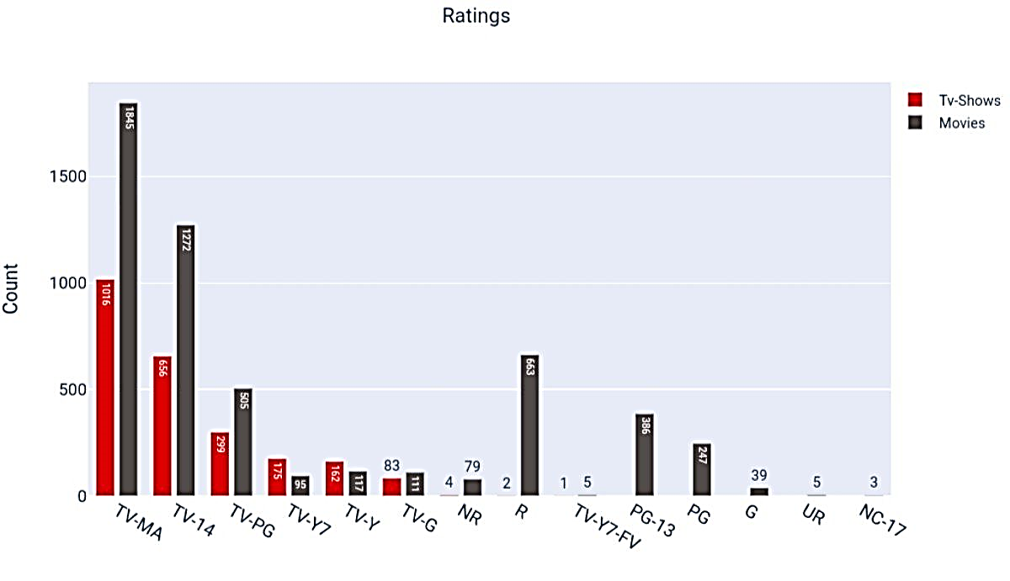
10.Summary of Content by Rating
We can observed from above table what rating is applicable for which age group, TV-MA that is Mature content is most feverate in netflix

Slide 21
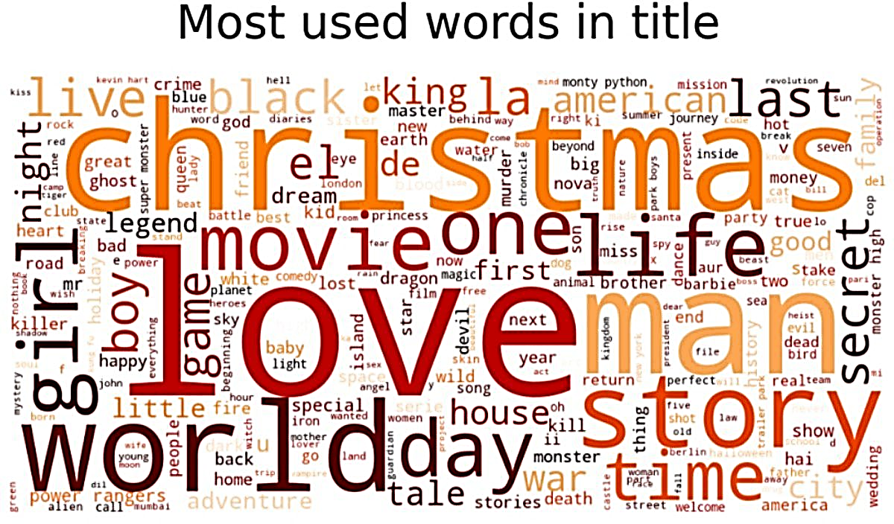
10.create a wordcloud to see which words appear the most in the titles for movies and tv shows
The most used words in title are visualized
There areseversl words that are mostly used likechristmas ,love,man ,story ,world ,movie ,day ,girl ,time ,last ,secret king.
These words are mostly used in Netflixas titles .

Slide 22
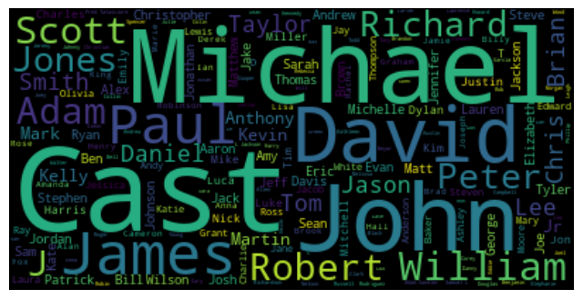
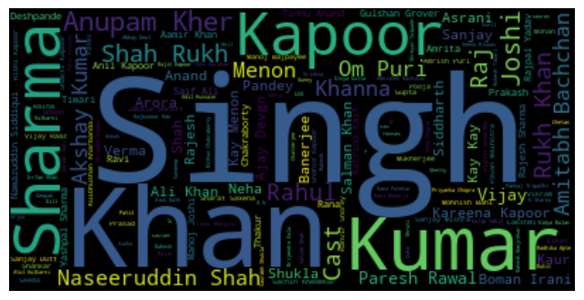
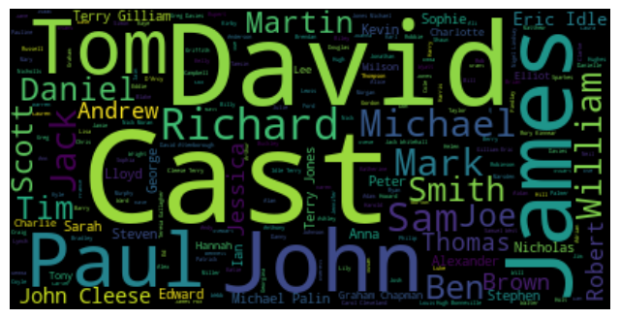
10.create a wordcloud to see which words appear the most in the titles for movies and tv shows
1.For India we can see Anurag Kashyab, Dhavid Dhawan, Gopal Varma, Dibakar Banerjee and many more.
2.For United Kingdom we can see Mathew, Adam, Michael, John and many more.
3.For US we can see David, Marcus, Scott, Adam, Johnson and many more

Slide 23
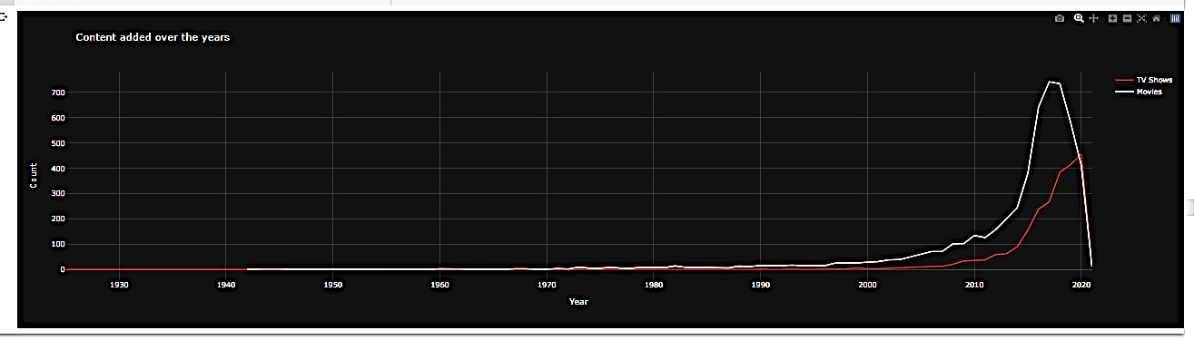
Is Netflix has increasingly focusing on TV rather than movies in recent years.?
Number of movies added to netflix is higher than that of TV shows. In 2018, netflix added 734 movies and 386 TV shows. So there we cannot conclude that netflix has switched focus from movies to TV shows.

Slide 24

Clustering
We have used 5 clustering algorithms:
1.Silhouette score(KMeans)
2.Elbow Method(KMeans)
3.DBSCAN
4.Dendrogram
5.Agglomerative clustering

Slide 25
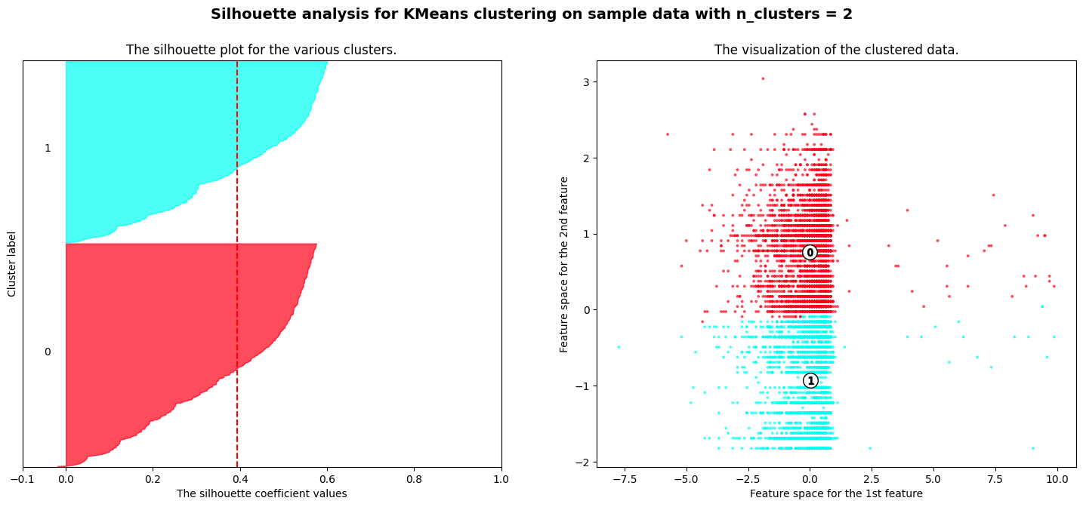
1.Silhouette score(KMeans)
Silhouette Coefficient or silhouette score Is a metric used to calculate the goodness of a clustering technique. Its value ranges from -1 to 1.
1: Means clusters are well apart from each other and clearly distinguished.
0: Means clusters are indifferent, or we can say that the distance between clusters is not significant.
-1: Means clusters are assigned in the
wrong way.
For n_clusters = 11 The average silhouette_score is : 0.39231962393545666
For n_clusters = 12 The average silhouette_score is : 0.3923191080640547
For n_clusters = 13 The average silhouette_score is : 0.3907297123344184
For n_clusters = 14 The average silhouette_score is : 0.3982108256771202
For n_clusters = 15 The average silhouette_score is : 0.40391820615952795

Slide 26
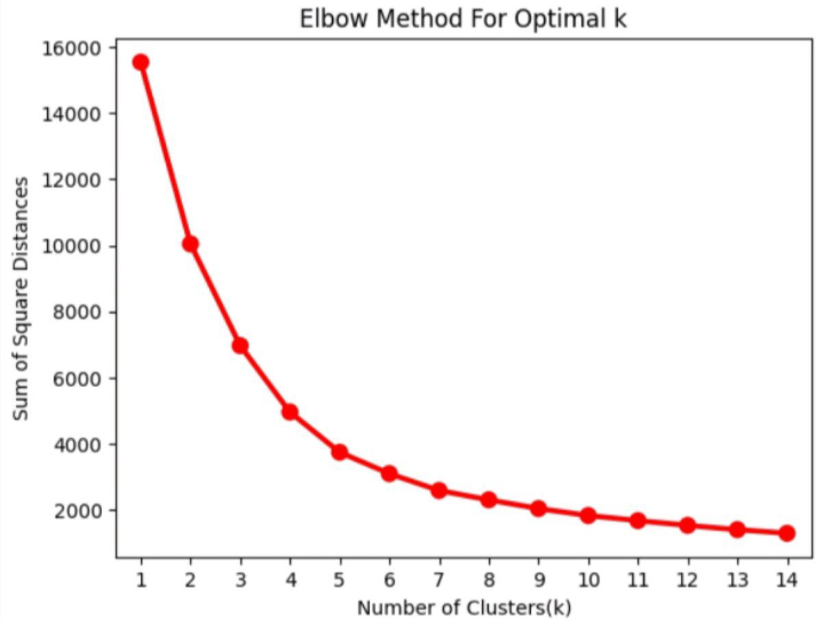
2.Elbow Method(KMeans)
The Elbow Curve is one of the
most popular methods to
determine this optimal value of k.
The elbow curve uses the sum of
squared distance (SSE) to
choose an ideal value of k based
on the distance between the data
points and their assigned
clusters.
Optimum number of cluster 6

Slide 27
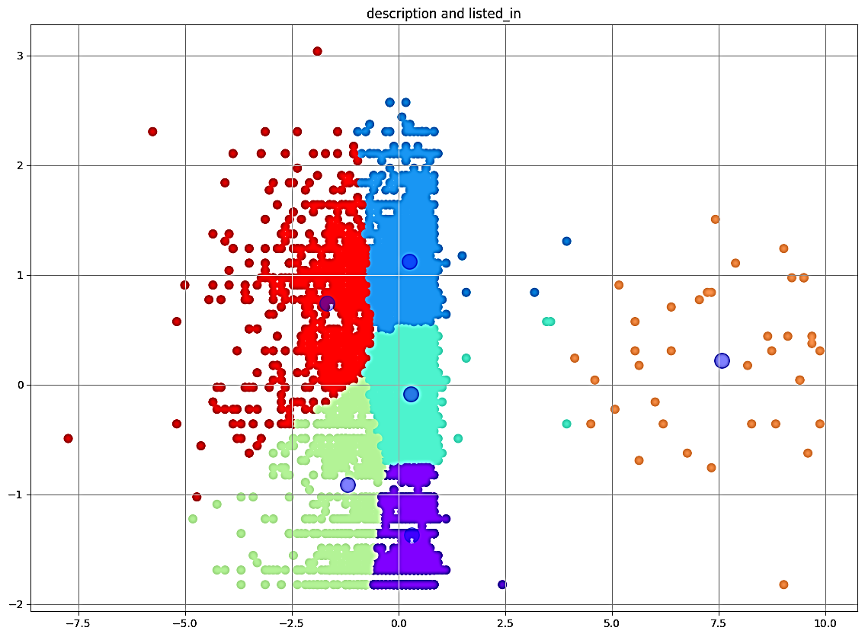
K-MEANS
K-means clustering is one of the simplest
and popular unsupervised machine
learning algorithms.
Typically, unsupervised algorithms make
inferences from datasets using only input
vectors without referring to known, or
labelled, outcomes.

Slide 28
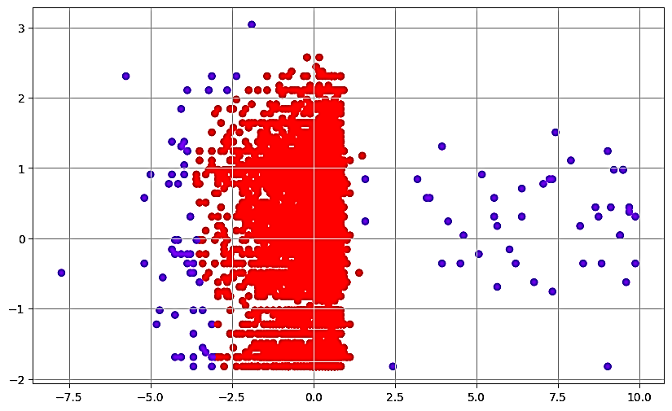
3.DBSCAN
DBSCAN is the acronym for Density-Based
Spatial Clustering of Applications with
Noise. DBSCAN is extensively used for the
identification of clusters in massive spatial
populations or datasets by taking the local
densities and properties of the data points
into account.
DBSCAN is especially useful for working
with outliers or anomalies and correctly
detecting these outliers and points that stand
out.

Slide 29
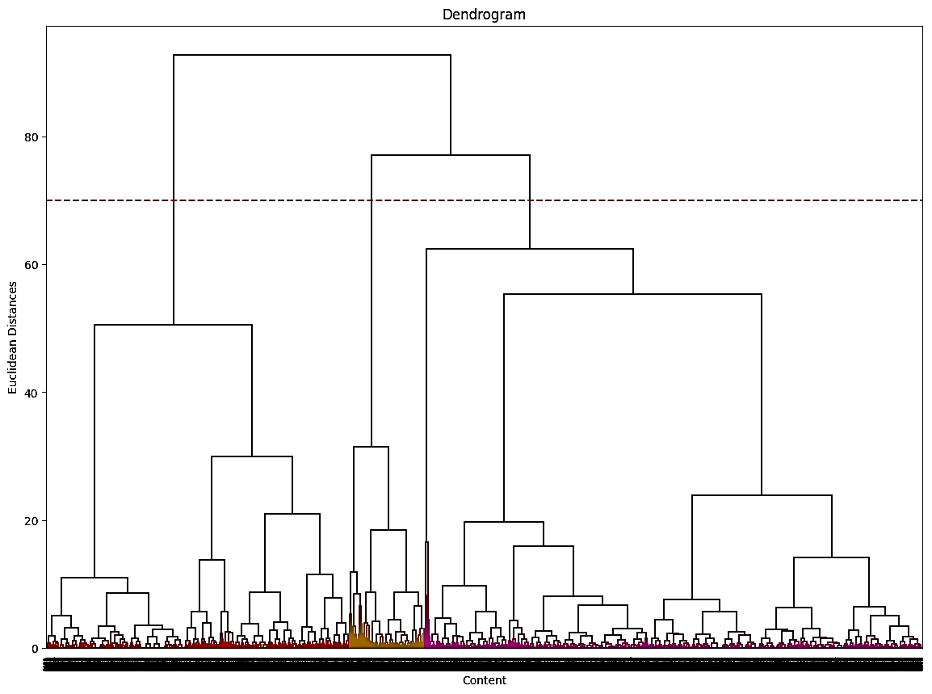
HIERARCHICAL CLUSTERING
Hierarchical clustering is also known as
Hierarchical Cluster Analysis (HCA) is
unsupervised Machine Learning.
It groups unlabeled data sets into groups also
Known as clusters.
In this algorithm, we develop the hierarchy of
clusters in the form of a tree, and this tree shaped structure is known as the Dendrogram

Slide 30
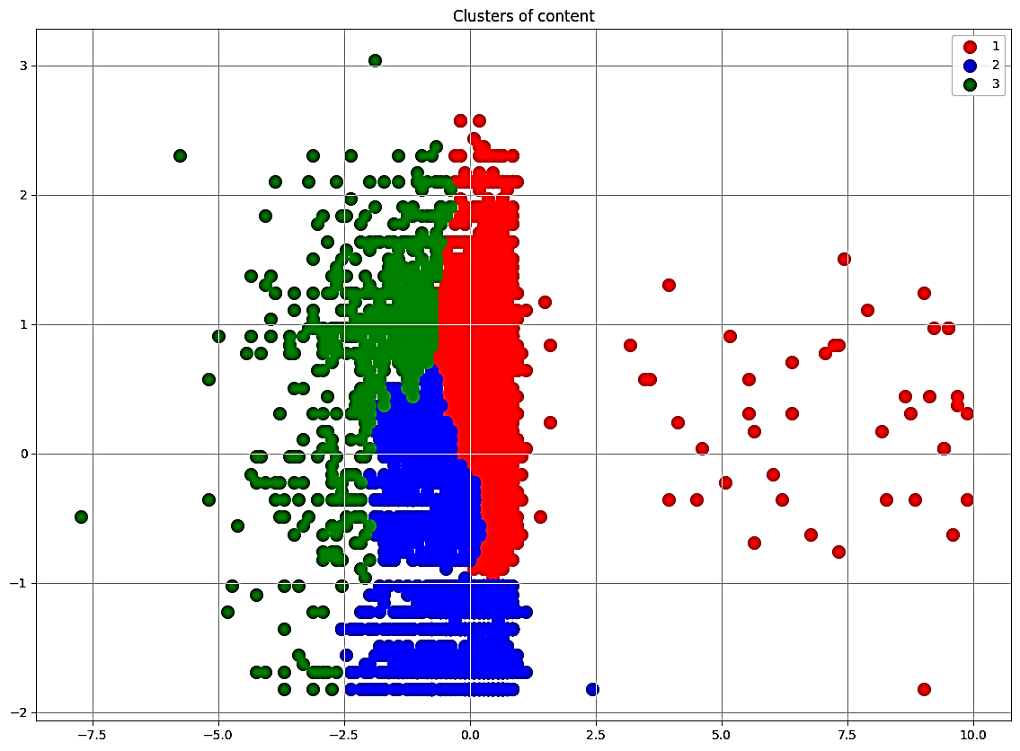
4.Agglomerative Clustering:
Agglomerative Clustering: Also
known as bottom-up approach or
hierarchical agglomerative clustering
(HAC).
A structure that is more informative
than the unstructured set of clusters
returned by flat clustering.
This clustering algorithm does not
require us to prespecify the number
of clusters.

Slide 31
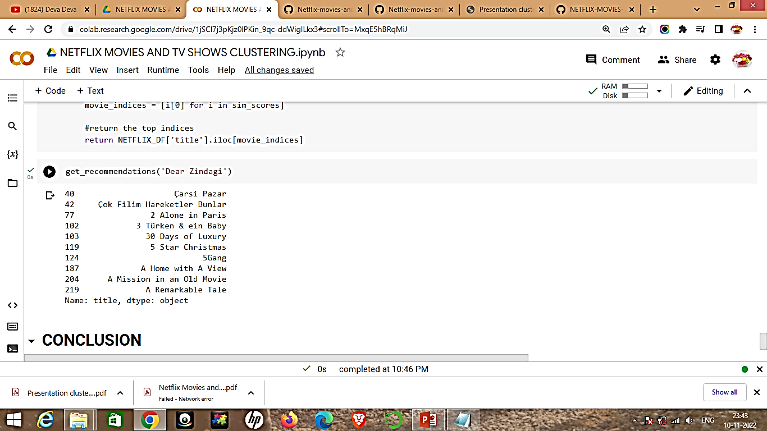
RECOMMENDATION SYSTEM
A recommender system, or a
recommendation system, is a subclass
of information filtering system that
seeks to predict the “rating” or
“preference” a user would give to an
item.
They are primarily used in commercial
applications.
The famous Netflix Prize is also a
competition in the context of
recommendation systems.

Slide 32
Conclusion
1.Netflix has 69% of its content as movies, so we can say that movies are clearly more popular on Netflix than TV shows. Netflix has more movies than TV Shows
2. United States provides the most number of movies and shows followed by India and United Kingdom.
3. TV-MA rated content is maximum in number in the dataset. This rating indicates that the content is for mature and adult audience above the age of 18
4. There is an exponential raise in the number of TV shows and movies distributed by Netflix in the recent years.
5. Optimal number of clusters were found out to be 15 with silhouette coefficient value of 0.040
6.Recommendation based on cosine similiarity is also done on the same transformed data.
7.Indian market is one of the biggest market after USA so Netflix should more focus on Indian market

Slide 33
Thank You

